Slide 1


ONCOLOGY HOSPITAL INFORMATION
MANAGEMENT SYSTEM
www.thegemini.co.in

Slide 2
What Is Oncology EMR Software?
Oncology is a complex specialty with unique terminology and protocols, especially when it comes to ordering and administering chemotherapy. One of the biggest challenges oncology clinics face is ensuring orders are documented properly and regimens are followed accurately, since there are significant consequences if the wrong drug or dosage is administered. Therefore, many oncologists are adopting electronic medical records (EMR)/electronic health records (EHR) to help reduce these risks, limit liability and increase quality of care.
Oncology EMRs, also referred to as electronic health records (EHRs), are designed to meet the unique requirements of oncologists. First and foremost, this means managing the ordering and administration of chemotherapy drugs. These EMRs also have unique cancer and hematology work flows and templates, and may have applications for reporting, cancer registry and clinical trials.

Slide 3
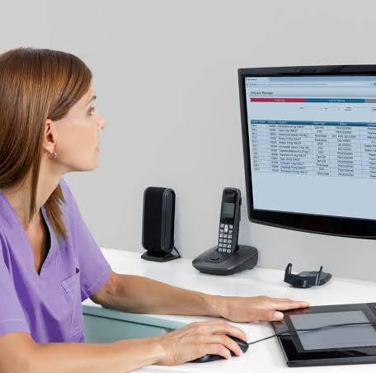
The Gemini
ONCO HIMS
THE GEMINI ONCO HIMS is committed to cultivating an environment that connects the entire oncology community. Our goal is to help every cancer care provider access the type of expertise, information and technology that enables smart, efficient, and high quality care globally. We are united by purpose to fight cancer, together. The Gemini Onco HIMS puts you at the center of the oncology care process. Using our solutions, providers can view the complete electronic medical record (EMR), with access to prior ambulatory visits, acute care encounters, test results, images, medications and other important clinical information.

Slide 4

Our Commitment
At THE GEMINI ONCO’s , we are a Partner for Life. This partnership is embodied in everything we do. Whether it’s working across teams, collaborating with customers, or reaching out to our communities, we are dedicated to our mission.
Our Mission
THE GEMINI ONCO’s mission is to innovate, support and simplify cancer-fighting solutions everywhere so we can realize our vision of living in a cancer-free world.

Slide 5
Features of ONCO HIMS
MAPPING & STAGING CLASSIFICATION
Based on the information provided, decision-support engines can map the cancer, identify the stage and recommend appropriate treatment options.
CHEMOTHERAPY AUTOMATION
Automated dosing, ordering and scheduling prevents errors by making orders easier to read, manage and administer. Oncology HIMS should also incorporate the documentation for drug admixture and administration, including inventory management for accounting for any billable waste.
ONCOLOGY SOAP NOTES TEMPLATES
Because every form of cancer is different, oncology HIMS include specialized templates for different kinds of cancer (melanoma, sarcoma, neoplasm, leukemia etc.), different types of treatment (chemotherapy, radiation therapy, surgery etc.) and other unique situations. When selecting your EMR, make sure the templates are most effective for the type of oncology you practice and for your individual workflow.
DIGITAL IMAGING & LAB TEST INTEGRATION
Mammograms, ultrasounds, CTs, MRIs and PET scans are just a few of the digital tests oncologists perform in assessing patients during diagnosis and treatment. Ensure that the tests you perform—and the specific tools you use—integrate into your EMR, allowing to store data and track progress over time.
CLINICAL TRIAL SUPPORT
If your practice is involved in—or considering being involved in—clinical trials, it’s important to select an HIMS that supports this aspect of your practice. Features might include a database of current research and ongoing trials and automated patient-trial eligibility matching, both to find existing trials for new patients and to bring existing patients into newly approved trials.

Slide 6



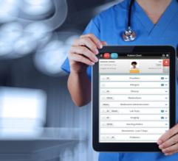


Advanced features help improve care quality and user throughput
Customizable plan of care
Evidence based chemotherapy regimen library
Decision support
Safety alerts
Order management
NCI’s CTCAE based adverse event documentation
Automated drug dosage calculations (/m2, /kg, AUC )
Drug utilization forecasting
Provider note templates
Therapeutic class based drug indexes
Integrated charge capture
Advanced reporting
Flow sheets
Gold Certified e-Prescribing
Nurse documentation
PACS / DICOM Imaging

Slide 7

THE GEMINI
ONCO HIMS
ADVANTAGE :
A growing collaborative network of cancer physicians at the forefront of caring for cancer patients
Expertise in advanced integration with all major EHRs
Built-in support to promote clinical trial accrual to advance your research endeavors
Simplified decisions for using precision medicine with evidence-supported diagnostic testing guidance
Insight into variations in care patterns and clinical trial accrual performance
Supporting documents for your oncology care team and patients

Slide 8

THE GEMINI ONCO HIMS
ADVANTAGES :
Cloud-based, HIPAA compliant SaaS model
Robust clinical data model – enabling thorough outcomes reporting
Ultra-configurable architecture
Includes an interface appliance, supporting the HL-7 and
other protocols, for EHR connectivity
On demand report generation and data exports
Service line and specialty dashboards
24x7x365 availability
Multi-device support

Slide 9
ONCO DIFFERS :
PATIENT JOURNEY IS UNIQUE AND DIFFERENT THAN NORMAL PATIENTS
  Patients are put to multi-modality treatment
  Multi drugs
  May be multiple specialties get involved
FINANCIAL TRANSACTIONS ARE DIFFERENTLY PATTERNED;
  May sometimes occur in cycles for even 20 years, as for example a breast cancer
  Every department has different modality and cycles
DIFFERENT FREQUENCIES ARE REQUIRED FOR DIFFERENT DEPARTMENTS EVEN TO THE INDIVIDUAL LEVEL OF PATIENTS
  Helps in preparedness of hospitals so that valuable time is not wasted
  Better follow up of patients
  Better treatment outcomes
UNIQUE NUMBER CAN BE ASSIGNED TO THE PATIENTS APART FROM UNIQUE ID
  This number may be a reflection of cassettes being used for radiation or a drug vial batch number
  This can help in performance tracking of highly valuable instrument s like PET scans

Slide 10
THE GEMINI ONCO HIMS
MODULES

Slide 11
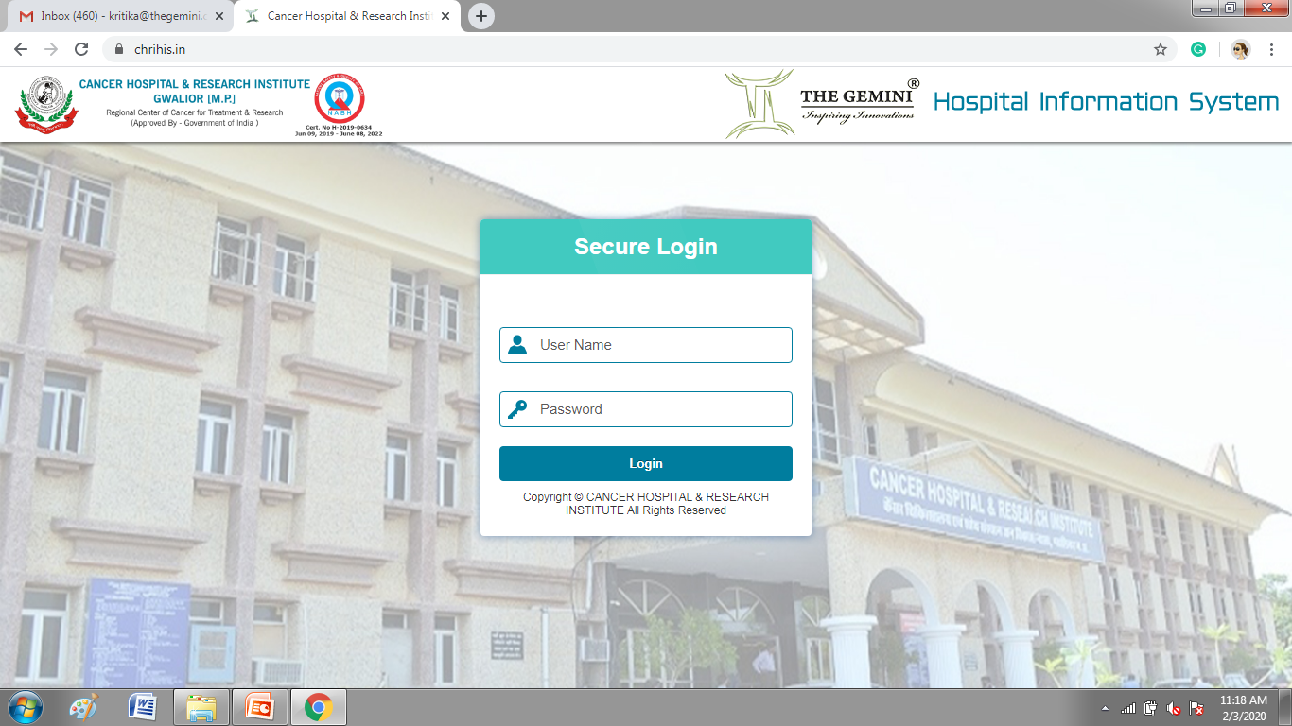

Slide 12
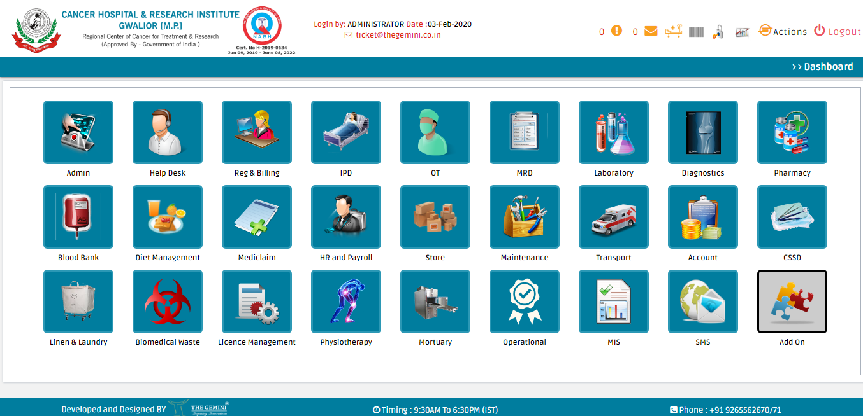

Slide 13
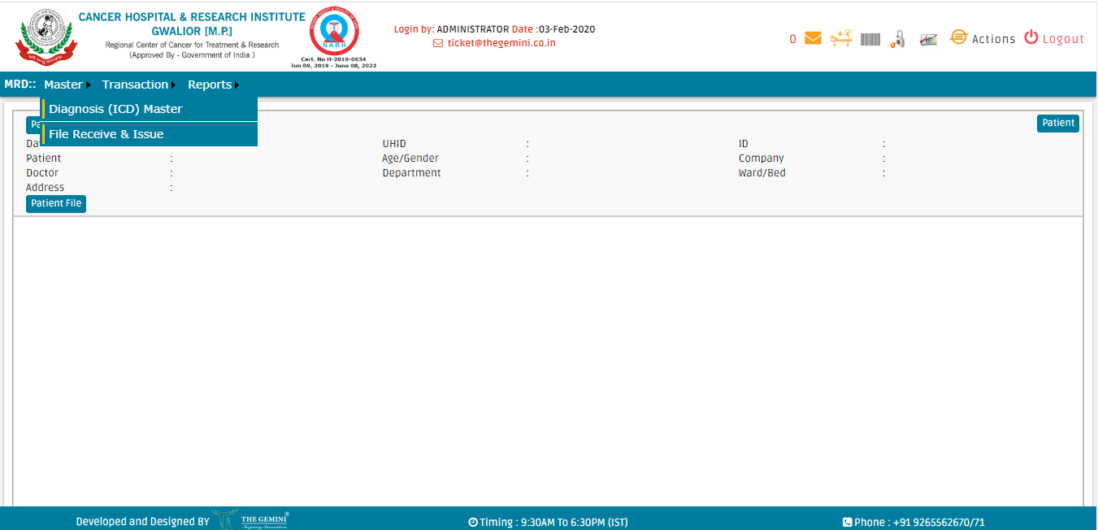

Slide 14
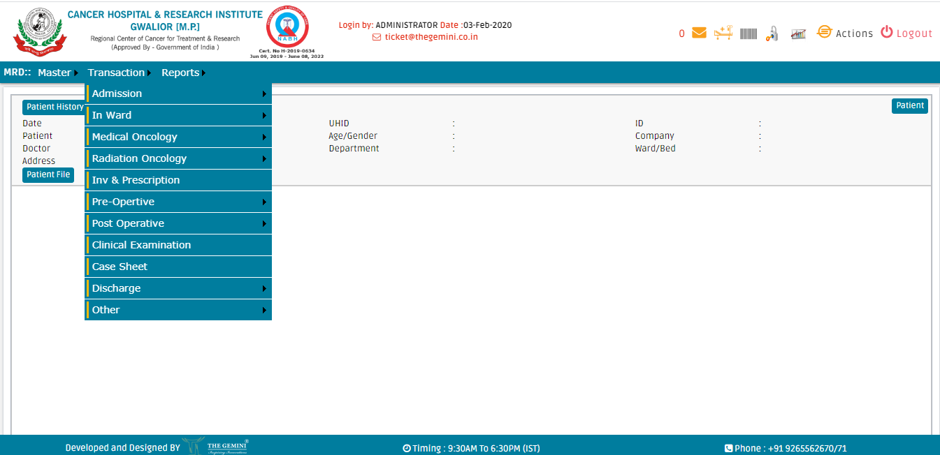

Slide 15
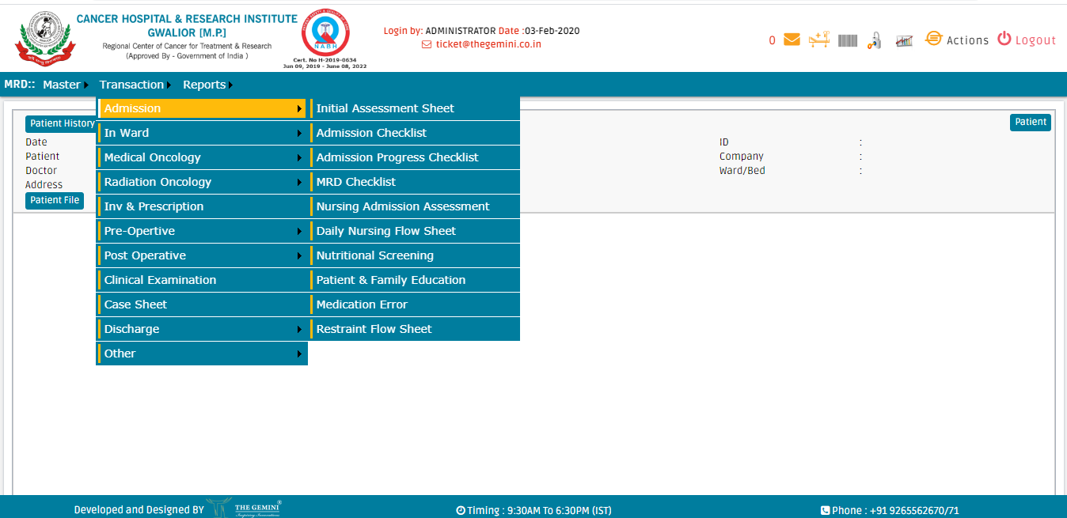

Slide 16
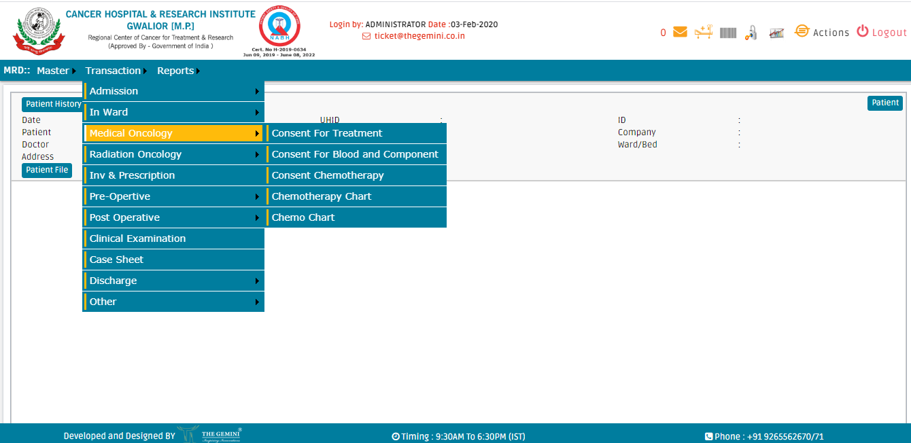

Slide 17
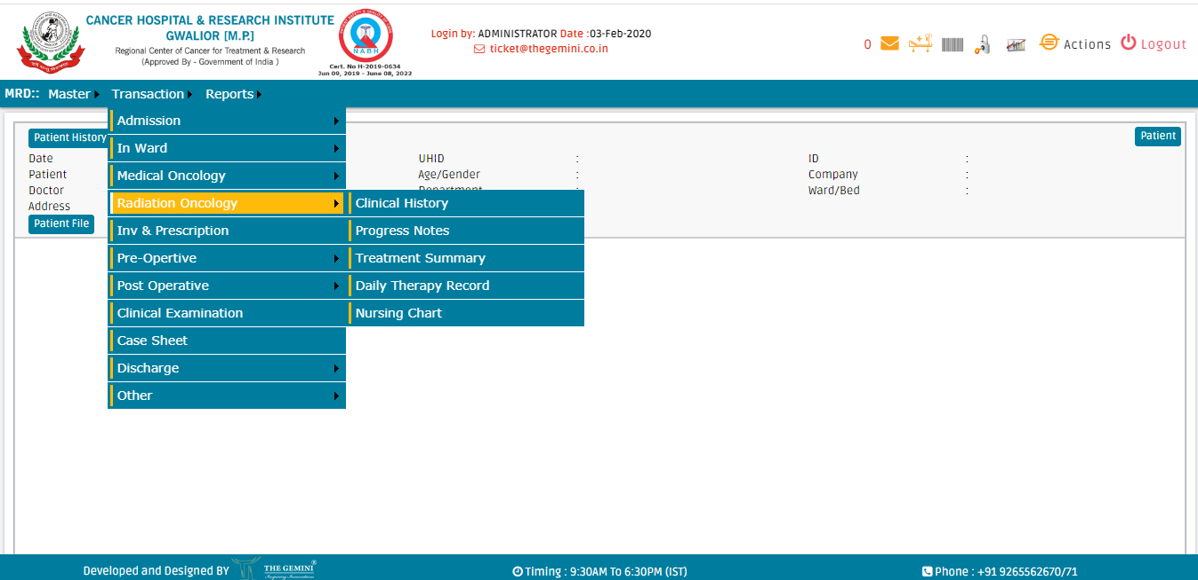

Slide 18
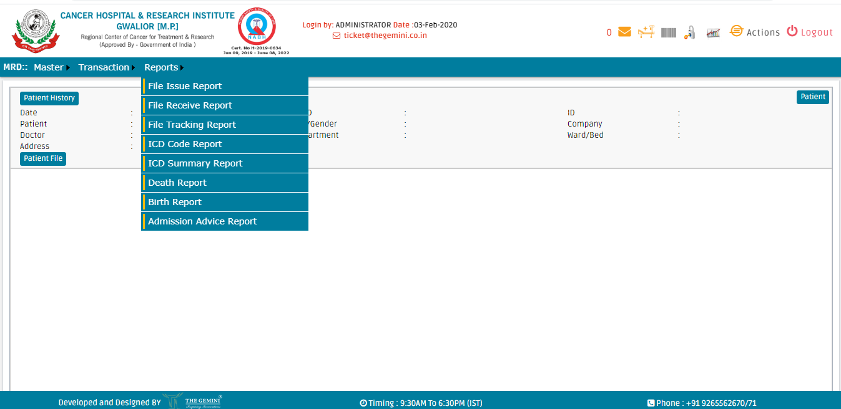

Slide 19
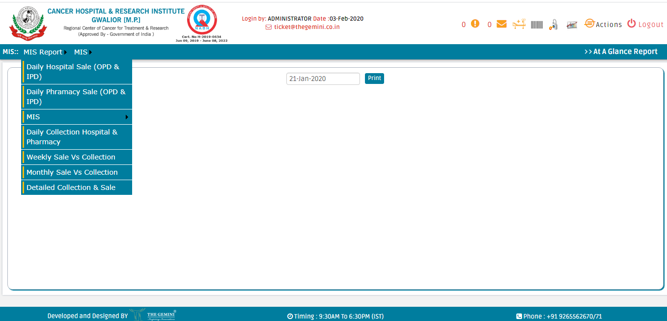

Slide 20
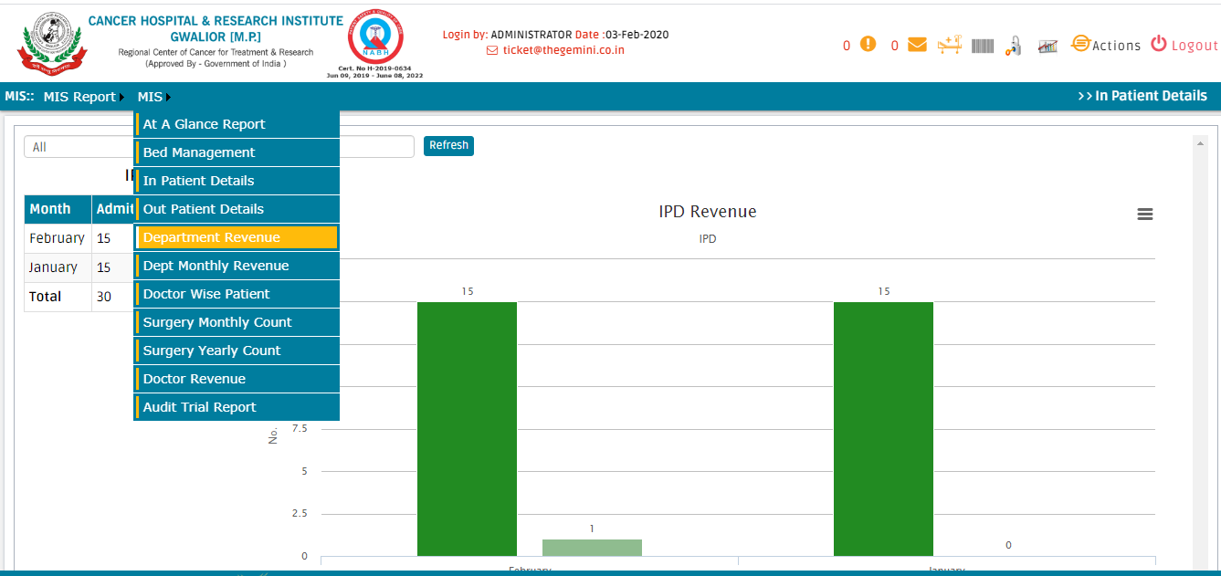

Slide 21
Top 5 Oncology EHR Software by EMR Finder:
EMRFinder values its customers and has compiled a list of the 5 best and top-rated Oncology EMR & PM software solutions for physician practices in 2019. The list is solely based on customer reviews and ratings and is as follows:
MOSAIQ EMR Software
CureMD EMR Software
iKnowMed EHR Software
Kareo Clinical EHR Software
OncoEMR Software

Slide 22
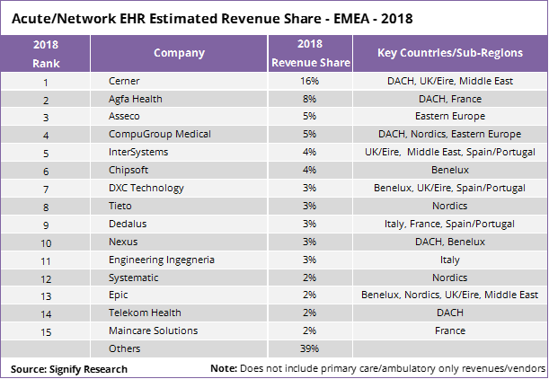

Slide 23

EHR STANDARDS FOR INDIA

Slide 24
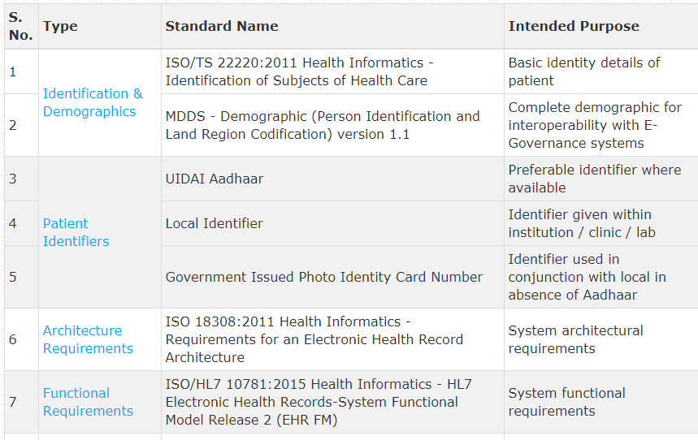

Slide 25
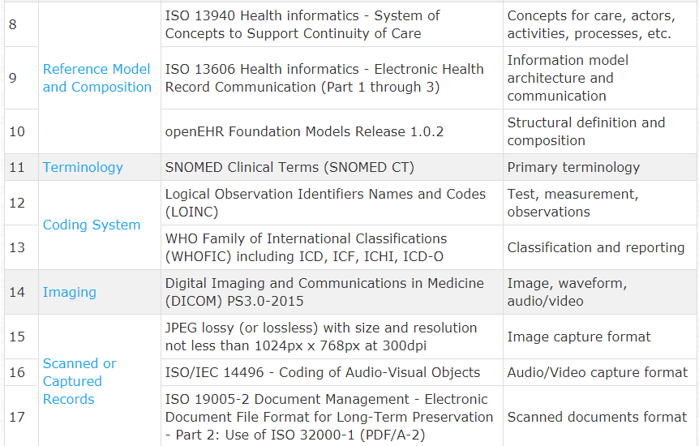

Slide 26
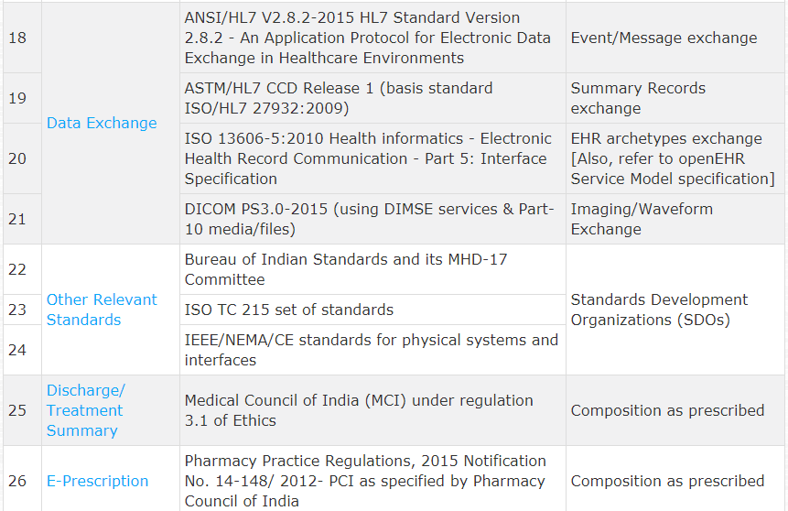

Slide 27
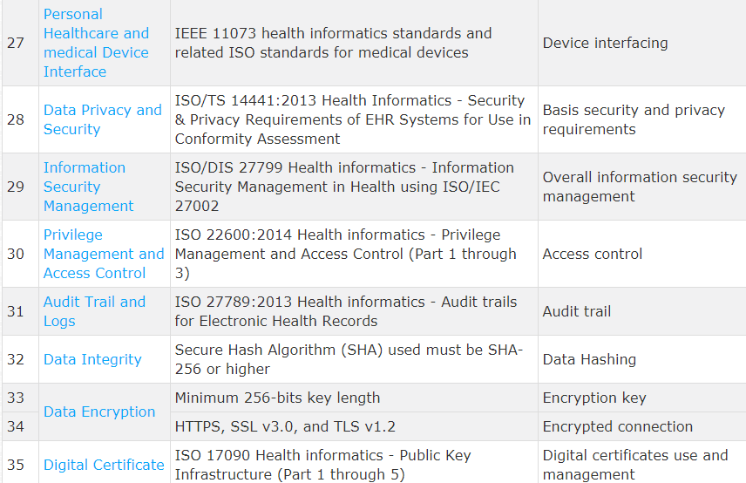

Slide 28

CONTACT US :
TO DISCUSS YOUR NEEDS OR FOR A COMPREHENSIVE DEMONSTRATION OF THE PRODUCT OR SERVICE CONTACT US :
Call : +91 9265562676
Email: consultants@thegemini.co.in
Visit : www.thegemini.co.in
DEVELOPMENT CELL:
AHMEDABAD, AJMER, KOLKATA
TECHNICAL SUPPORT:
UDAIPUR, MUMBAI, BANGALORE, NOIDA, PUNE, SILVASSA
BUSINESS ADDRESS :
BERLIN, GERMANY
THE GEMINI PARTNER :
NIGERIA, KENYA, UGANDA, UAE, TRINIDAD

Slide 29

THANK YOU

